Slide 1


AKYVER® Silence
Green house effect/ IR
Noise
Noise
Light
« The new intelligent sheet »

Slide 2
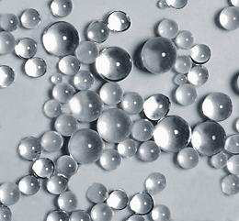
AKYVER® Silence
European
Patent!
Your advantages:
1. Outstanding sound insulation
Best sound reduction, till 10 dB* (Rw)
Better behaviour on rain noise, till 11 dB * (Lia)
2. Diffusing natural light
3. Reduction of green house effect by better solar factor
4. Improved fire resistance
5. A unique aesthetic
* Measures CSTB done on sheet of 20 mm with and without beads

Slide 3
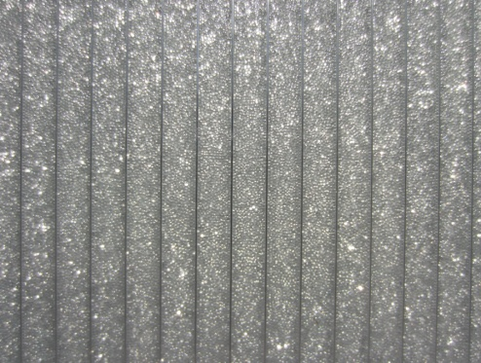
AKYVER® Silence
Description:
Cellular polycarbonate sheets filled with 1000µ glass beads
Available on our products:
~ Sheets in AKYVER ® 16 mm and 20 mm
~ Systems (ex: AKYVER® Panel 40- 8W)
~ Others on demand
    AKYVER ® Silence

Slide 4
AKYVER® Silence
Sound improvement:
Filling
AKYVER® 16-7 Silence *
AKYVER® 20-7 Silence *
Rw
Sound reduction
(dB)
Rw=28
Rw=30
Lia
Rain noise
(dB)
^{AKYVER® Sun Type 16 7 *}
Rw=20
Glass 4-16-4
^{SPC 16 3P + Aerogel *}
Rw=21
64
73
65
-
Rw=30
62
The microbeads provide an acoustic performance close to a standard double glazed
Nota:
Exterior noise: Rw index (C, Ctr) expressed in dB
The higher this index is, the less the noise disturbs the activity inside the building
Rain noise: Lia index expressed in dB.
The lower this index is, the less the noise disturbs the activity inside the building
To the ear, reducing the level of 10 dB represents twice less noise
* Measures or following CSTB technical approval

Slide 5
AKYVER® Silence
Light and energy improvement:
Filling
AKYVER® 20-7 Silence ⁽¹⁾
Light Transmission
LT (%)
46
Solar Factor (g-Wert)
0,43
64
0,66
Glass 4-16-4
80
0,63
SPC 16 3P + Aerogel ⁽²⁾
54
0,52
AKYVER® 16-7 Silence ⁽¹⁾
AKYVER® Sun Type 16-7 Opale ⁽¹⁾
~ 50
0,49
Thermal insulation
U (W/m².K) (U-Wert)
~ 1,8
< 1,8
1,5
1,5
2,2
The microbeads provide a good light scattering and limit the warming inside the premises
<1,8 à 1,9 (2)
Following the methods of measure
Nota:
LT: The higher the value is, the more the light passes through the filling and thus illuminates a room. The notion of diffusion is not considered in this index
g-W: The lower this index is, the less the sun radiations warm up a place
Purely indicative, being validated in the laboratory, (2) Datas from CSTB technical approval

Slide 6
AKYVER® Silence
Weight of fillings:
Filling
AKYVER® 20-7 Silence ⁽¹⁾
Weight (Kg/m²)
AKYVER® Sun Type 16 Seven
2,6
Glass 4-16-4
20
SPC 16 3W + Aerogel
3,6
~ 6,4
7,4
AKYVER® 16-7 Silence ⁽¹⁾
Significant weight gain in comparison
with a double glazing :
  Easier handling
  Less Fragile
Estimation by internal measuring,

Slide 7
AKYVER® Silence
Other characteristics:
~ Bendable 150 x thickness
~ Improved fire reaction by reducing the flame spread
~ Operating temperature: -40 à +110°C
~ Light effect possible (Office separators; stand; etc...)
~ Lighter supporting structure comparing to glass installation
Warning: possible only in cut-to-size dimensions, on order
=> Filling up in the factory

Slide 8
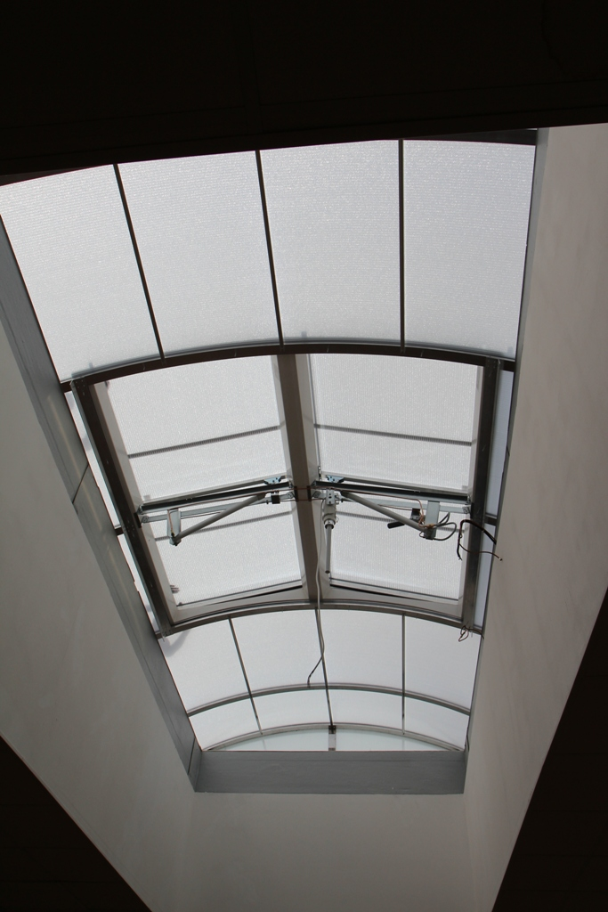
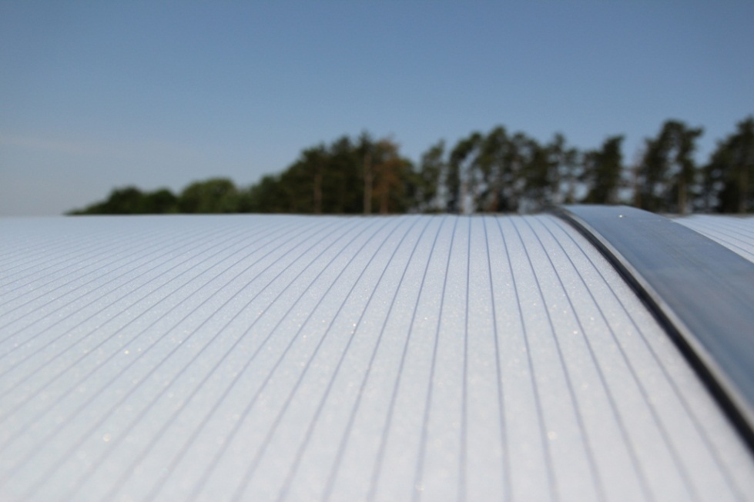
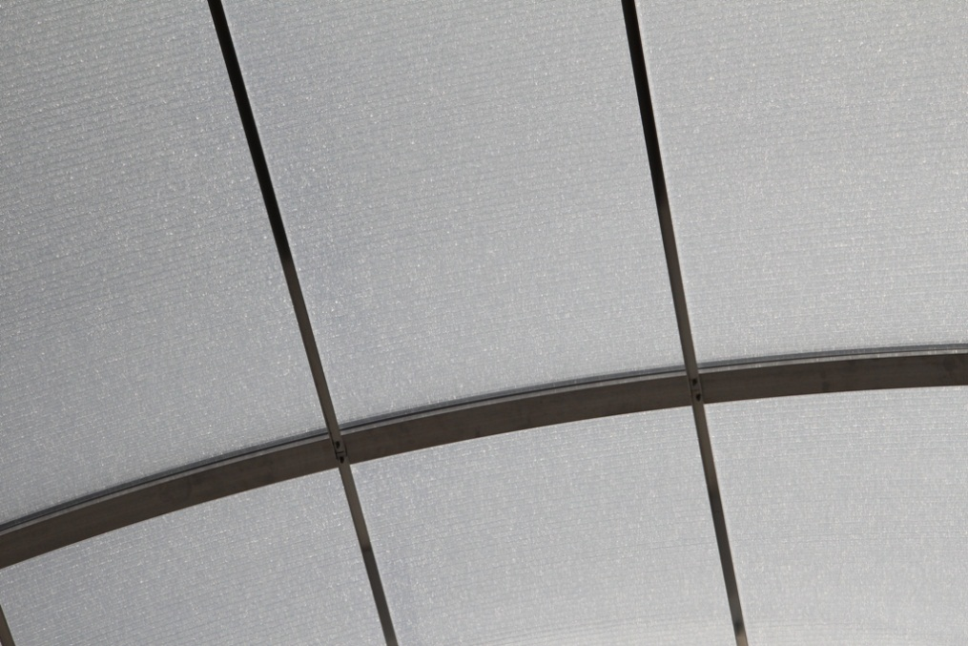
AKYVER® Silence

Slide 9
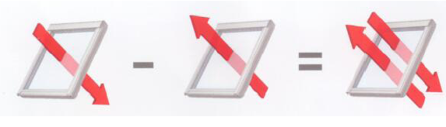
AKYVER® Silence offer you:
Sound insulation
Solar factor g
G-Wert
Thermal insulation U
(W/m²°K)
Outstanding energy and accoustic results

